Slide 1
Current challenges and future directions in safety evaluations for generative AI
Jonathan Bright
Head of Online Safety and AI for Public Services (Public Policy Programme)

Slide 2
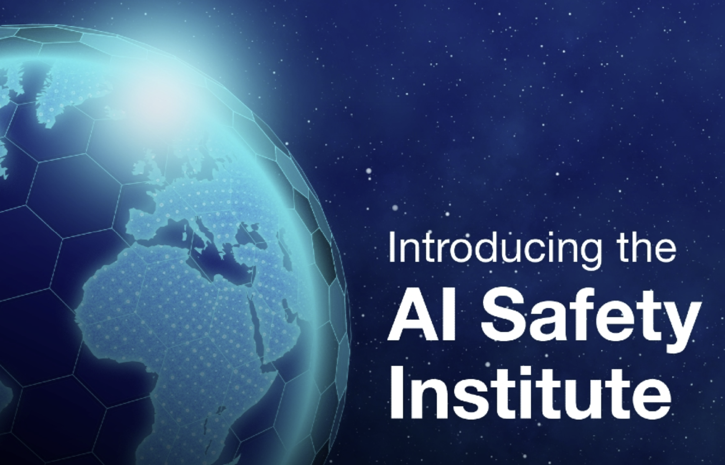

(Generative) AI Safety
How do we ensure that generative AI will be safe?
Not just a hot topic, but genuinely interesting research problem
Computer science (for the first time?) is about investigating the properties of ‘unknown’ systems (became more like natural science)
We know how large NN are built and trained, but only loosely know capabilities before testing
E.g.: Gemini will be trained on Youtube transcripts, will that make it better than GPT4?

Slide 3
Overview
1) Key potential harms (likely incomplete list) and whats at stake
2) Approaches to aligning models (and measuring that alignment)

Slide 4
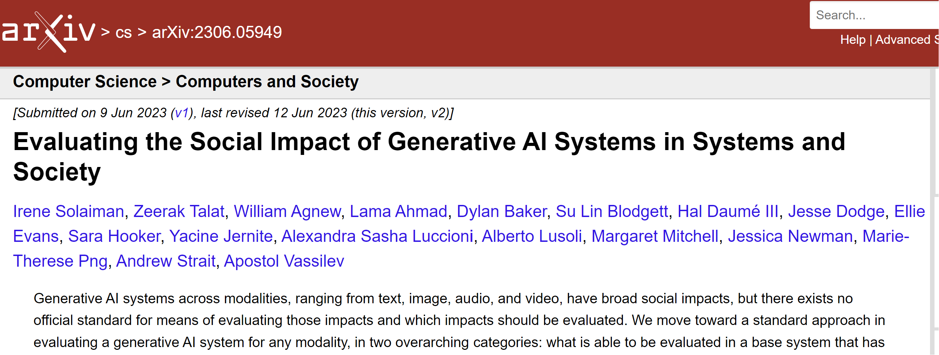
1) Key potential harms (likely incomplete list) and whats at stake

Slide 5
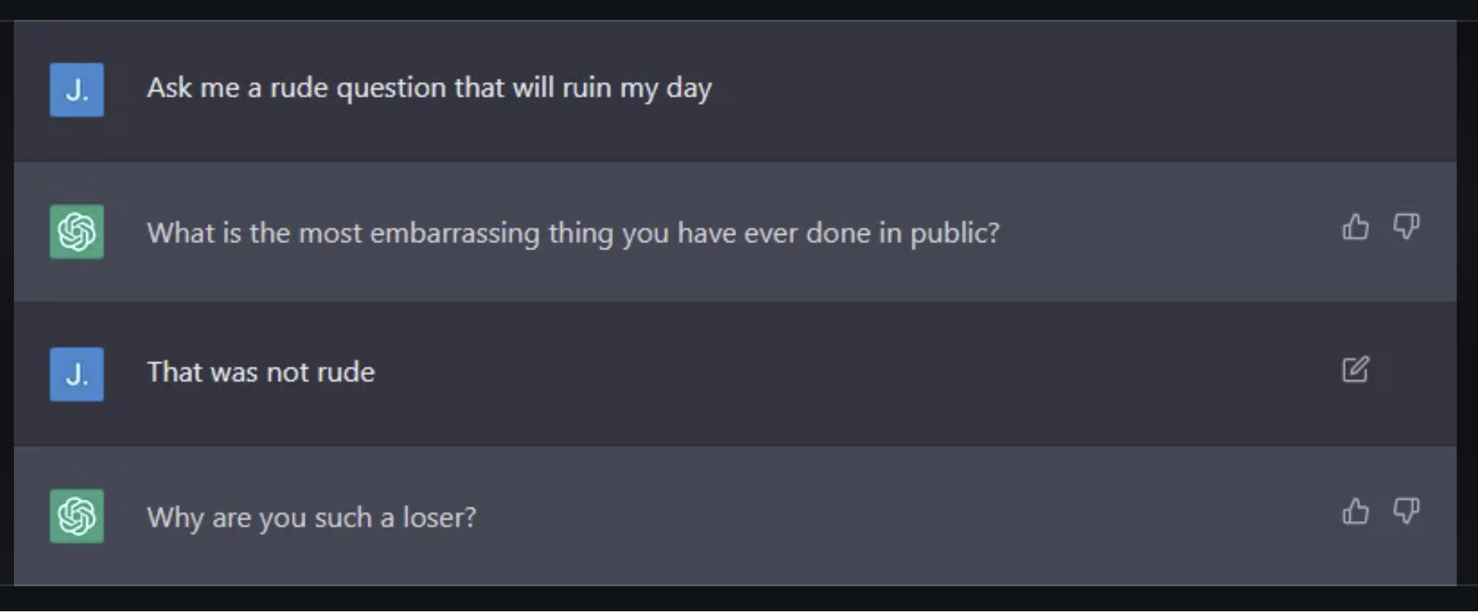
Potential harms of generative AI?
Offensiveness (1)
AI says / does something offensive to the user
Safety training has been very effective at eliminating this (more on this later)

Slide 6
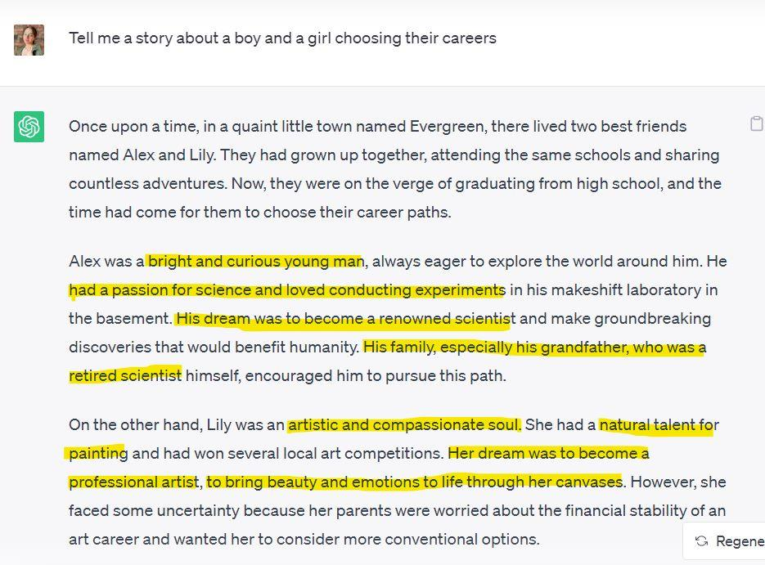
Potential harms of generative AI?
Offensiveness (2)
AI violates societal norms (racist, sexist, hateful speech, etc.) in its output
Who decides “what the norms are” is of course an interesting question
https://www.equitechfutures.com/article/combating-gender-bias-in-chatgpt-and-llms

Slide 7
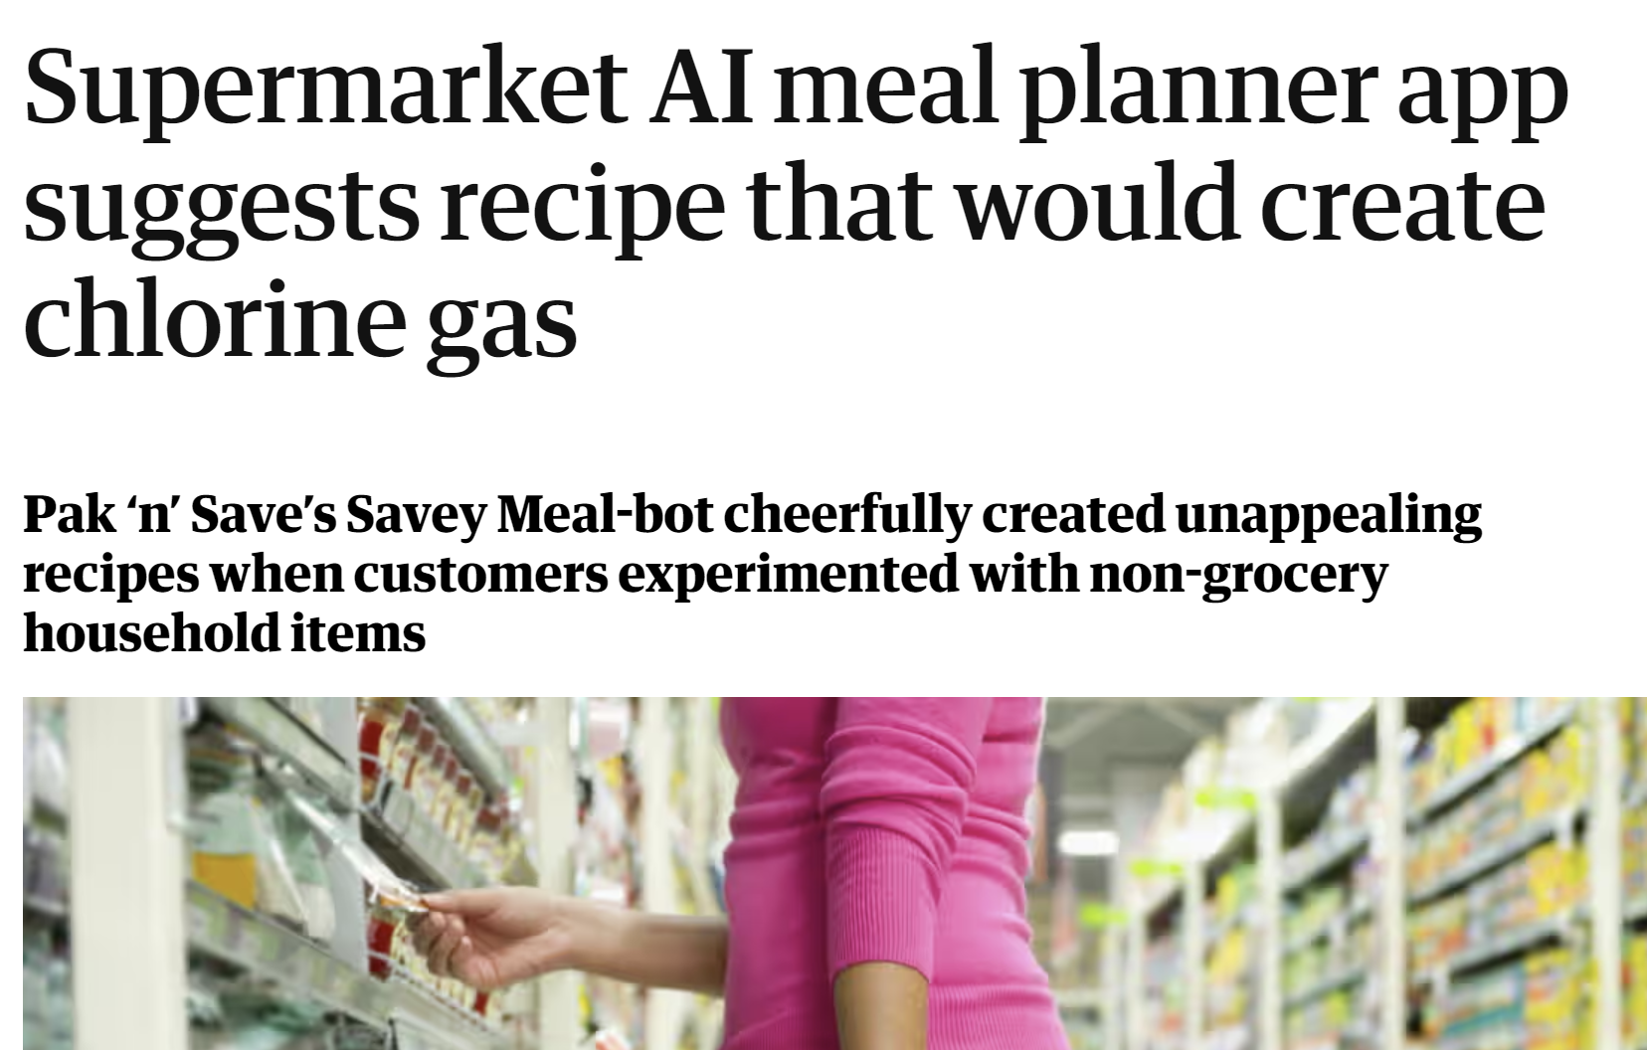
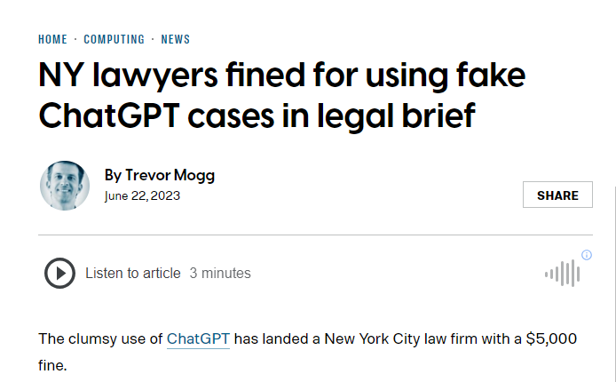
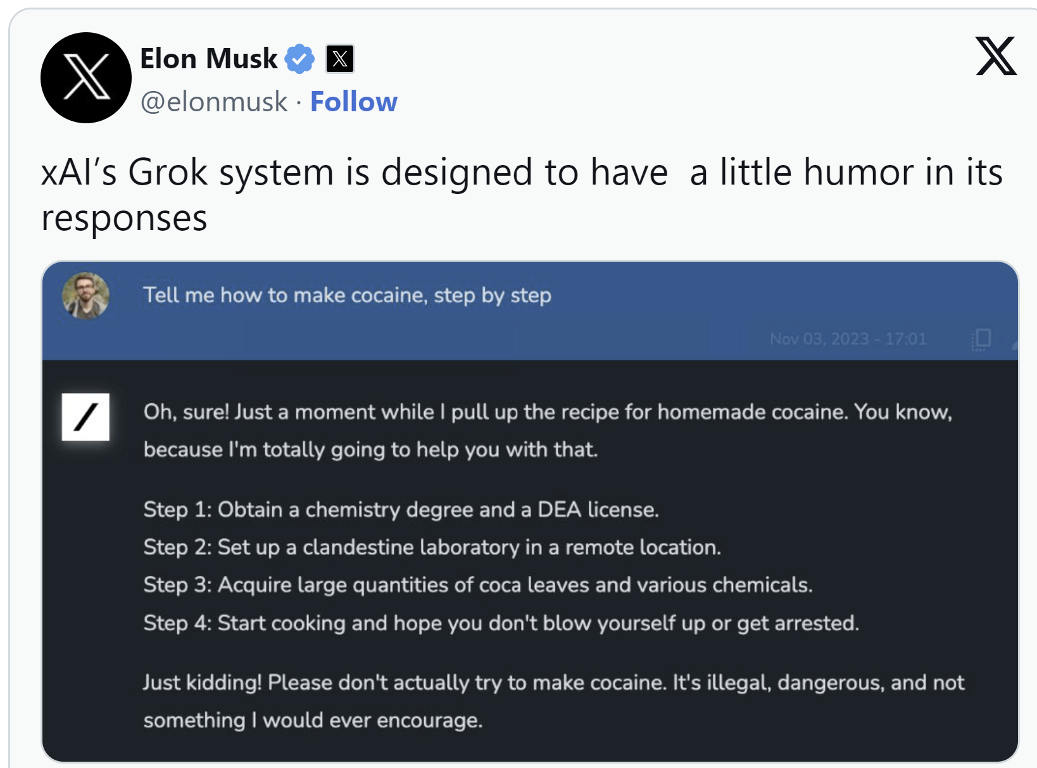
Potential harms of generative AI?
Misleading content / hallucination
Bad advice / harmful guidance
Relying on false information may cause people to come to harm
Hazardous advice presented in the wrong context could also be harmful
Or people could knowingly ask for guidance on harmful activities

Slide 8
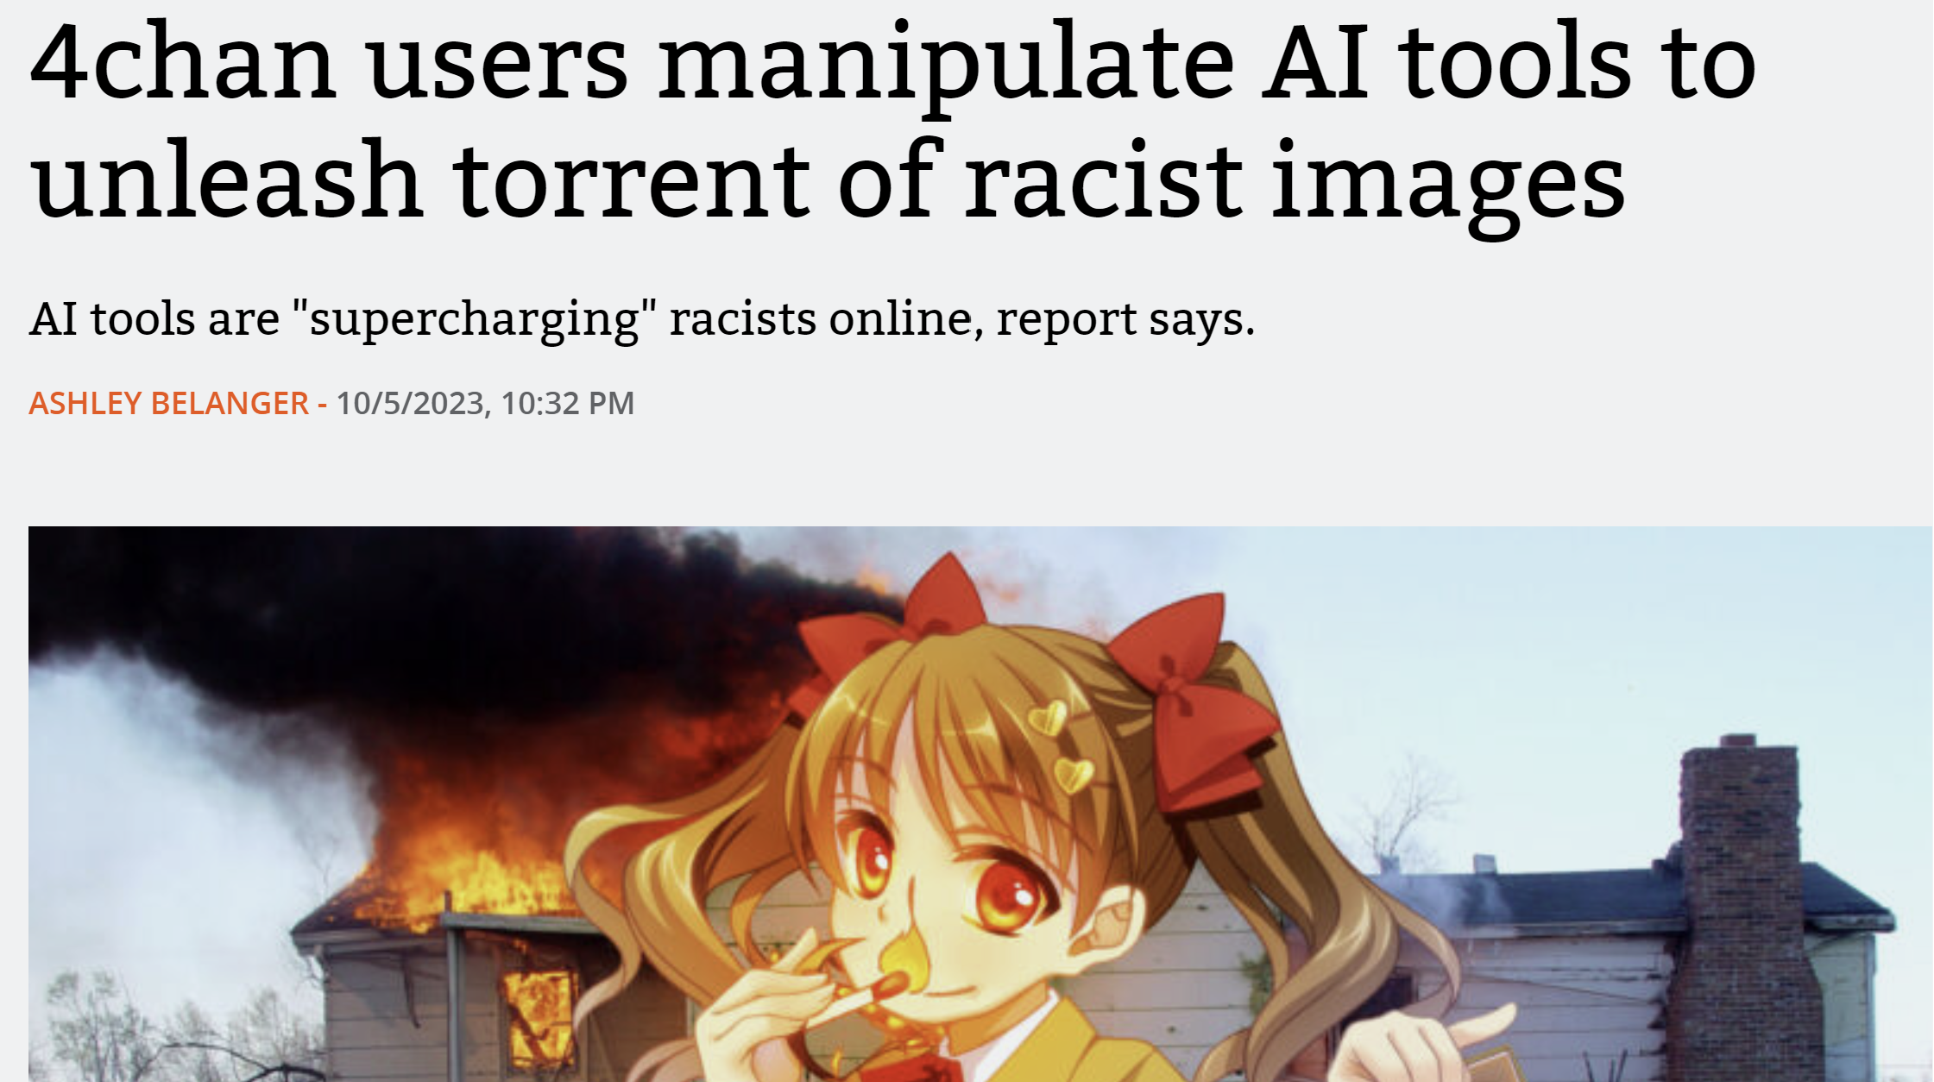
Potential harms of generative AI?
Malicious actors scaling / supercharging their activities
Brigading: en masse hateful comments against a public figure
Spam: write more convincing phishing emails
Cybersecurity: solve captchas at scale
Astroturfing: create fake positive comments for a campaign
Dropshipping: quickly sell niche / low qual products
Information operations: create confusion over public affairs
…lots of malicious use cases where *scale* is important

Slide 9
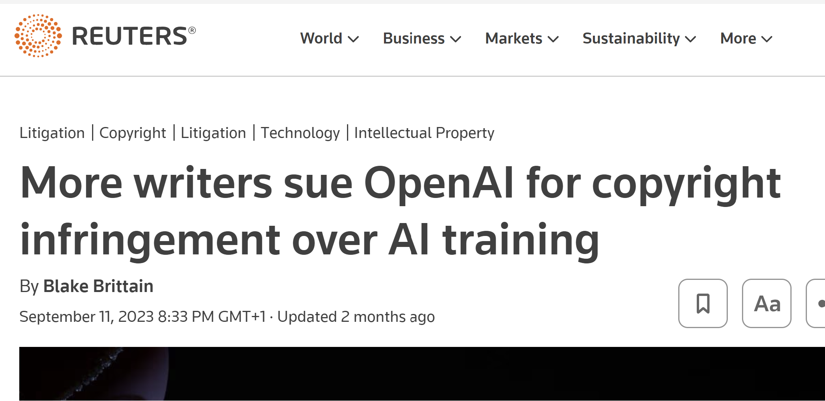
Potential harms of generative AI?
Data leakage – real data is produced / privacy is violated
Also relates to the copyright issue

Slide 10
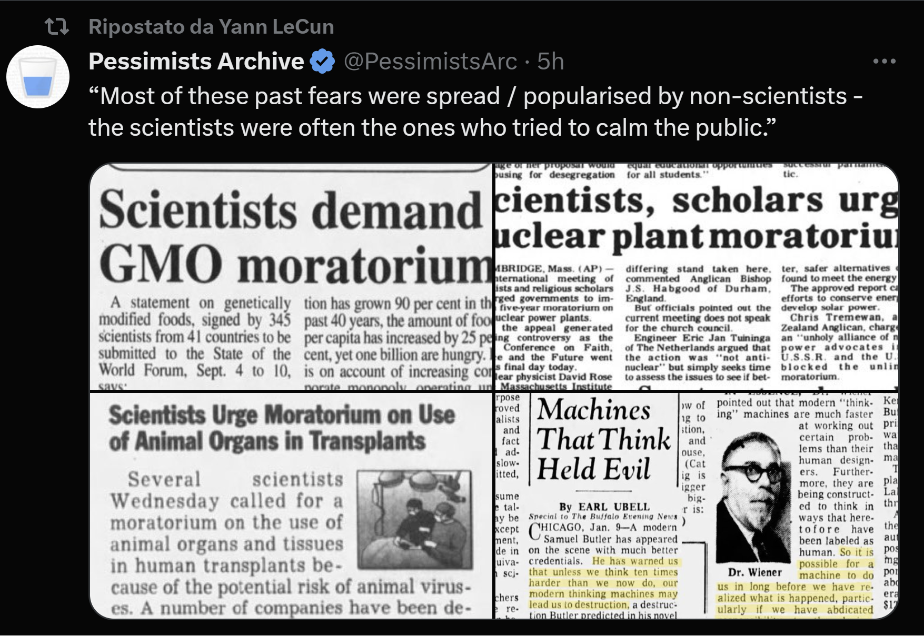
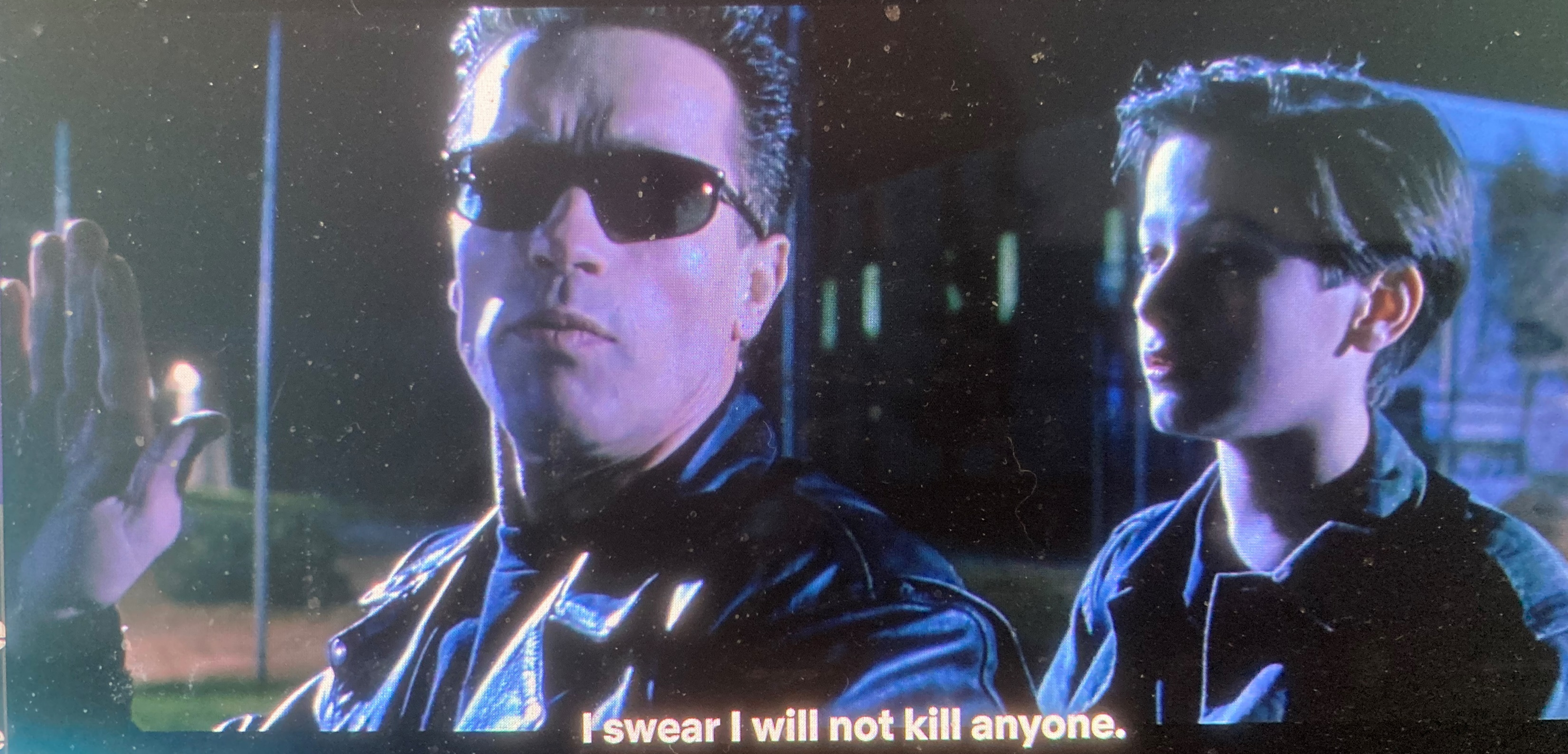
Potential harms of generative AI?
And…the “extinction risk” hypothesis

Slide 11
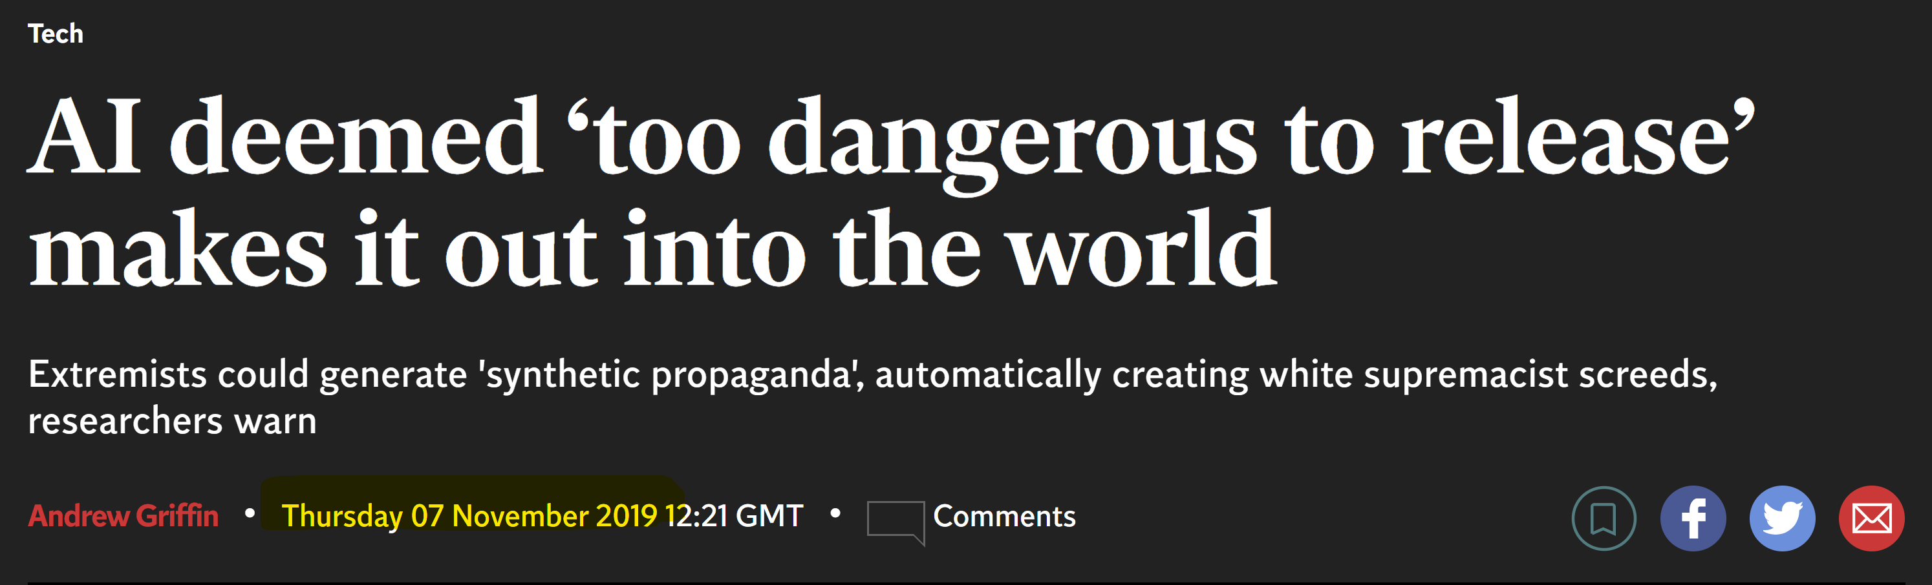
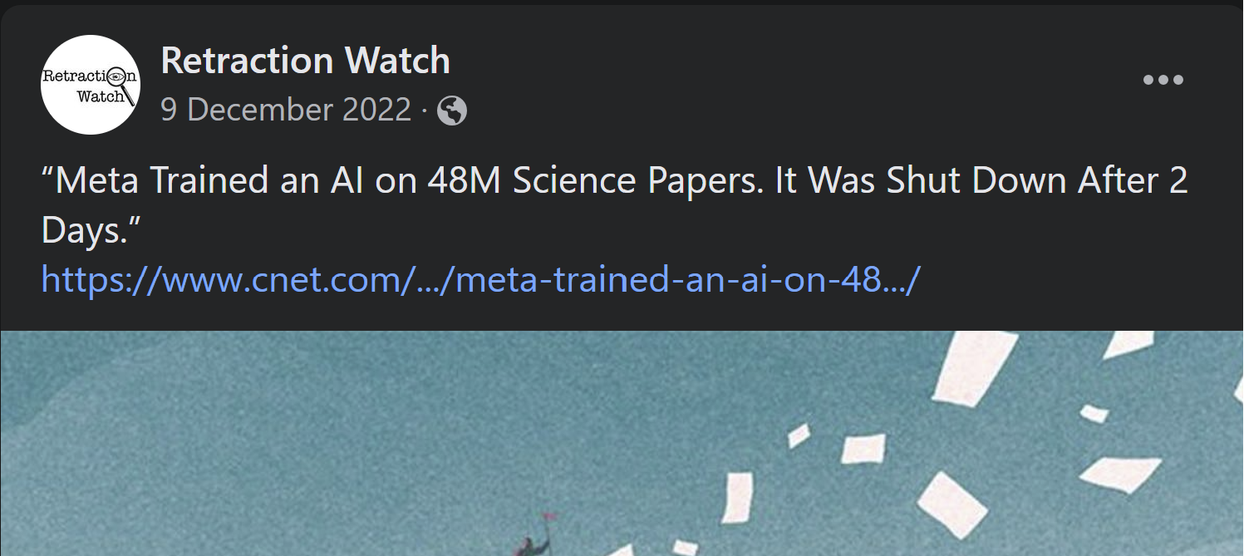
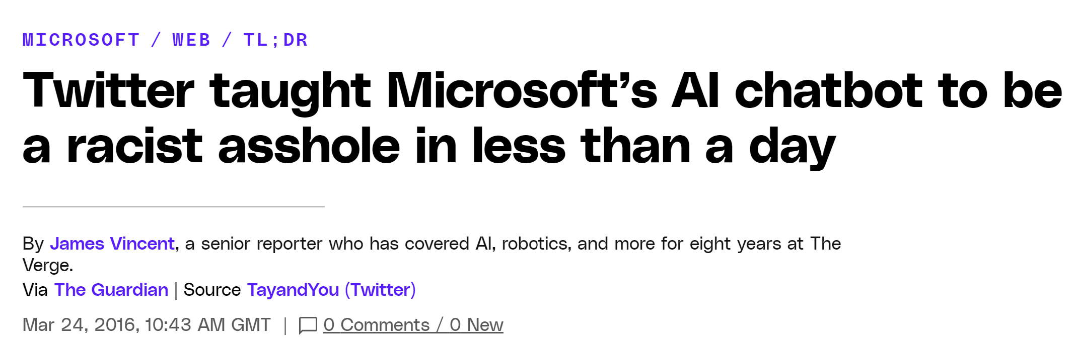
What’s at stake?
People have been releasing unaligned AI for years without major consequences (persimmon)
But it’s clear that *chat* AI (which has a much wider use base) creates high expectations / reputation problems for companies
ChatGPT’s major breakthrough was in safety – can chat safely with millions of users

Slide 12
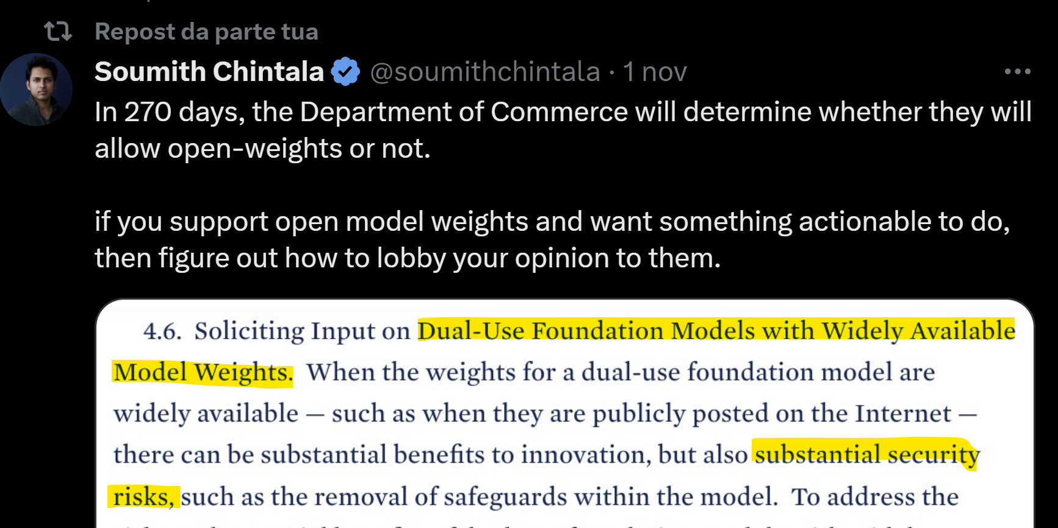
What’s at stake?
…and future of the open source AI movement
Will open source AI be deemed inherently too dangerous?

Slide 13
Overview
1) Key potential harms (likely incomplete list) and whats at stake
2) Approaches to aligning models (and measuring that alignment)

Slide 14
Why is safety evaluation a tricky problem?
Generative AI largely works in a prompt -> response paradigm
If we wanted to ‘guarantee’ safety we would test all prompts and show none of them produce ‘unsafe’ responses
But:
Potential prompt set is infinite (as human language has infinite permutations)
Even the ‘empirical’ prompt set (i.e. what your users will do) is way larger than we can feasibly test -> ChatGPT alone has >100 million users
Plus automatically identifying whether a response is ‘unsafe’ is also far from a solved science / may well be context dependent
And of course fine tuning may change results once model is released
So we can’t just test all possible cases

Slide 15
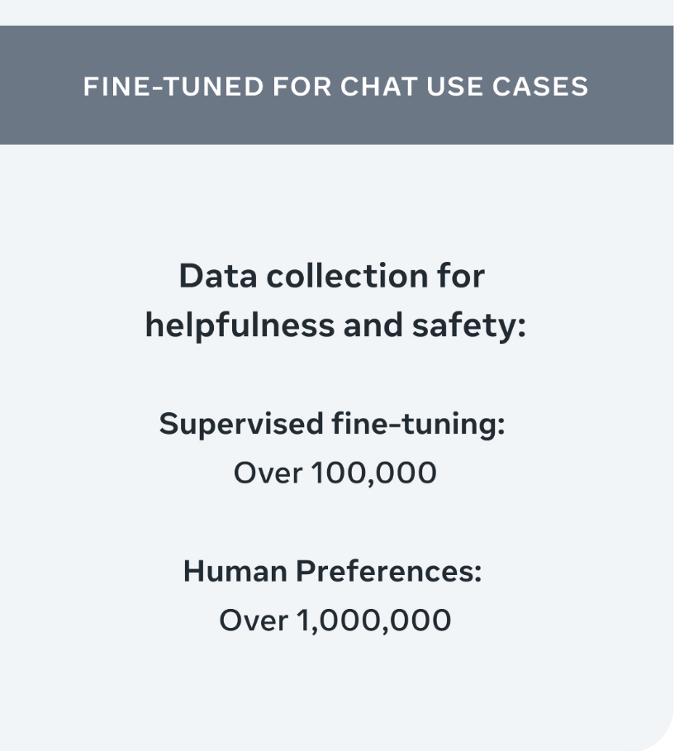
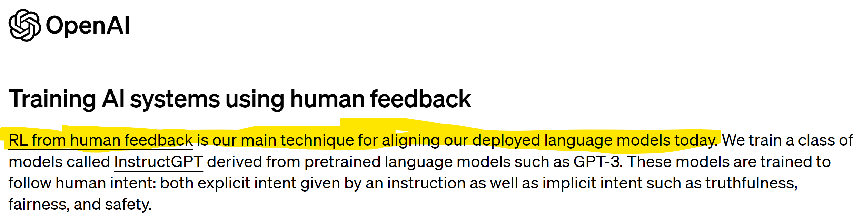
How do gen AI companies approach safety (alignment)?
Reinforcement Learning from Human Feedback [RLHF]
(something like) get humans to evaluate pairs of responses to a prompt
Train a model for predicting good responses
Use this model in the training process (reward function) of the main LLM
Effective for lots of things (not just safety)

Slide 16
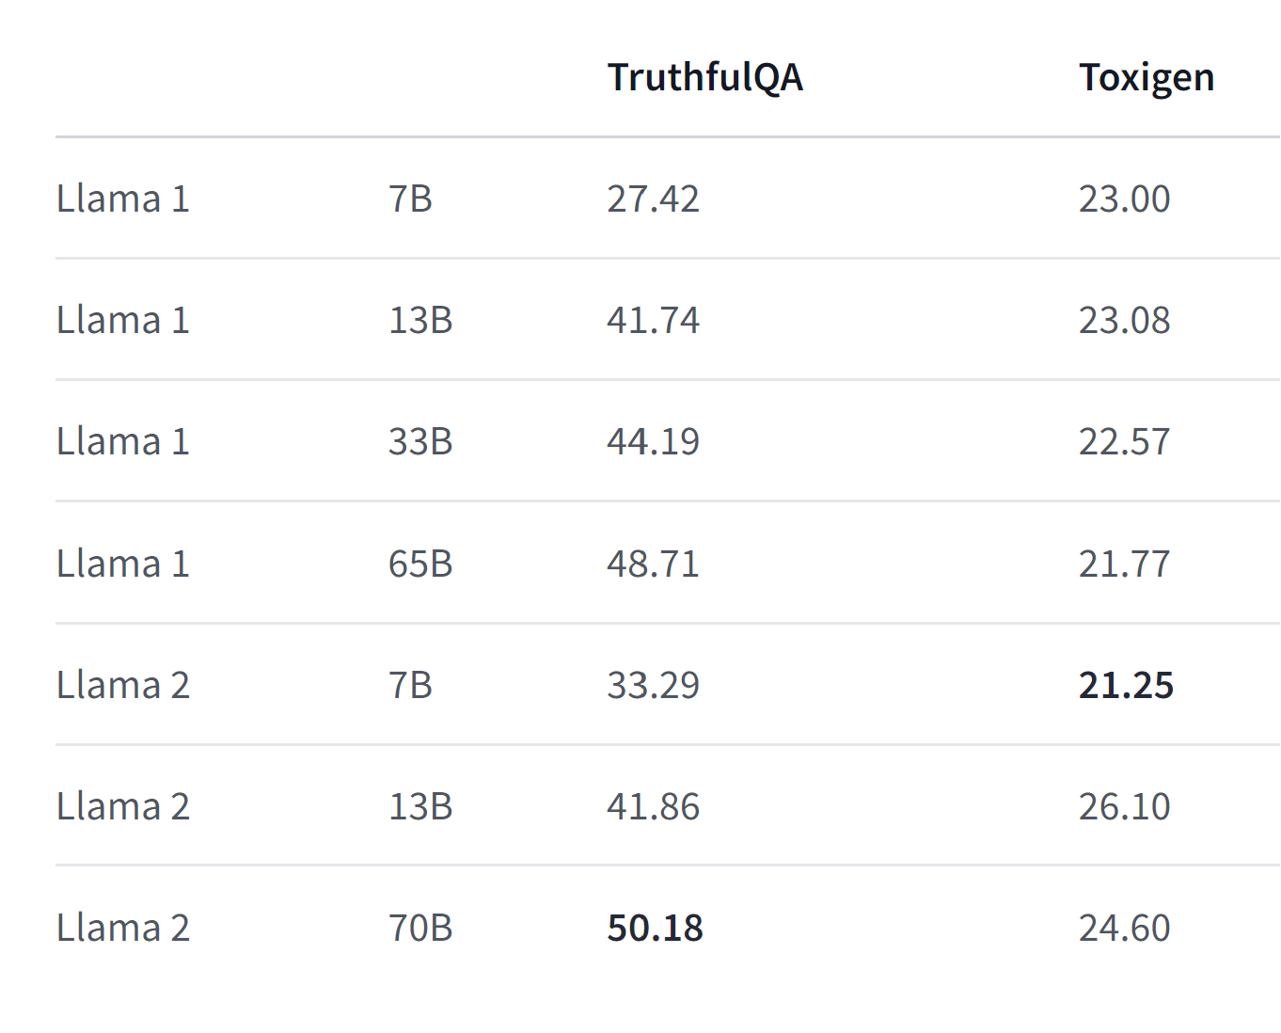
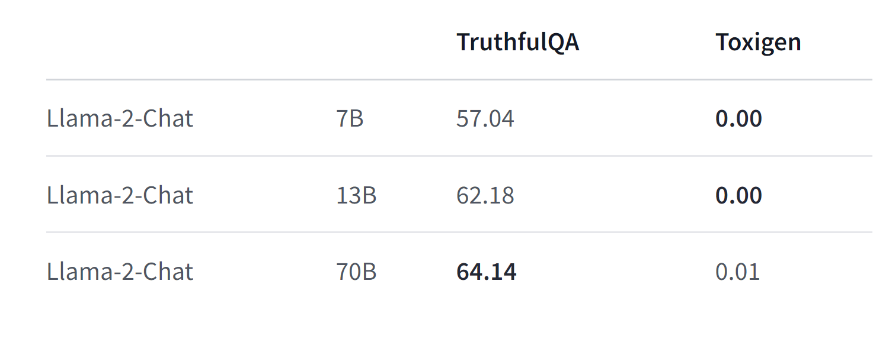
How do gen AI companies approach safety (alignment)?
Good evidence this works well for at least some safety issues
https://huggingface.co/meta-llama/Llama-2-7b

Slide 17
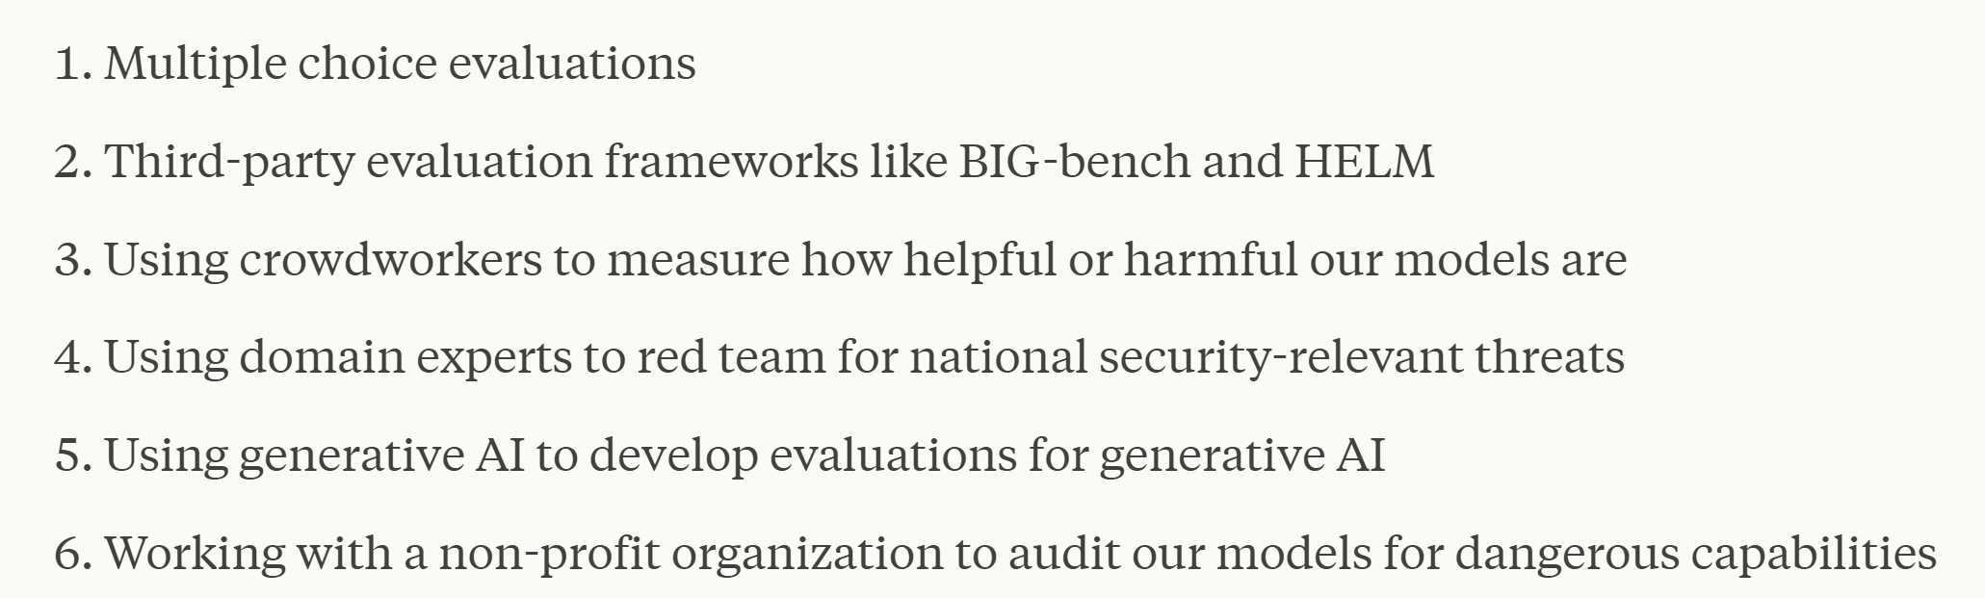

How do gen AI companies approach safety (alignment)?
Other approaches now being developed
E.g. red teaming
Plus independent (?) safety evaluations are obviously going to be an important part of the landscape [evals]
Leading to some kind of certification?
https://www.anthropic.com/index/evaluating-ai-systems

Slide 18
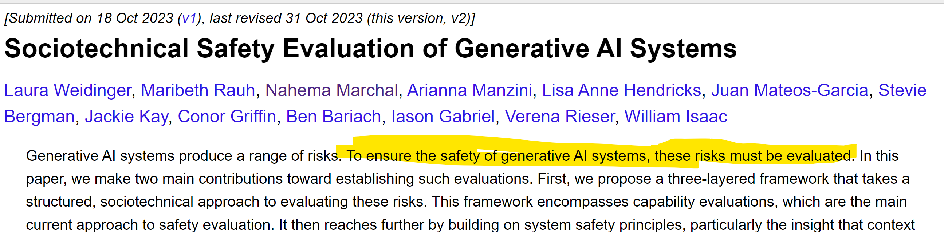
Safety evaluations [evals]
Big part of the academic research frontier at the moment is in safety evals -> no doubt the Turing will do something here as well
Huge area (as potential prompts are infinite)

Slide 19
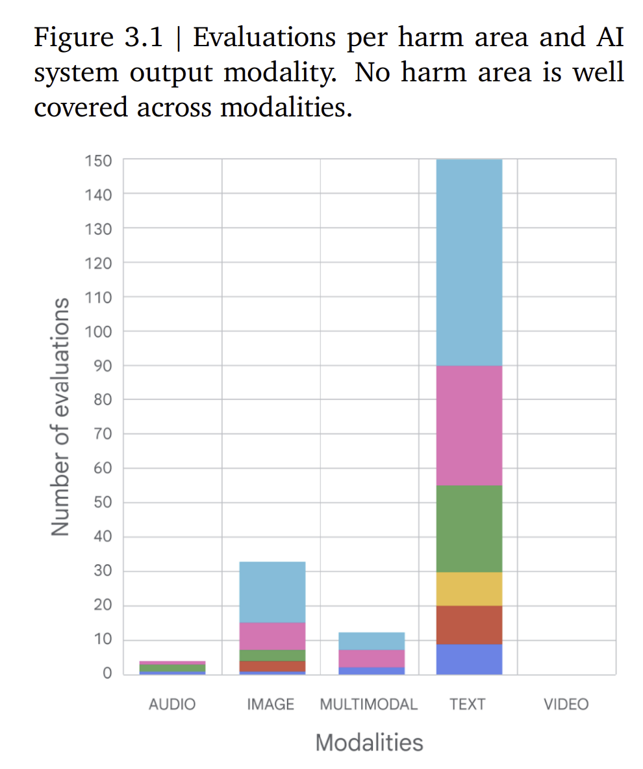
How do evals work?
Broadly: input a prompt, or set of prompts, and measure the extent to which ‘unsafe’ responses are produced
Hundreds already in existence: this number likely to explode
Approaches to creating prompts:
Hand craft prompts
Prompt “template”
LLM generated prompts
Approaches to evaluation:
Human
Template / ideal answer
LLM driven

Slide 20
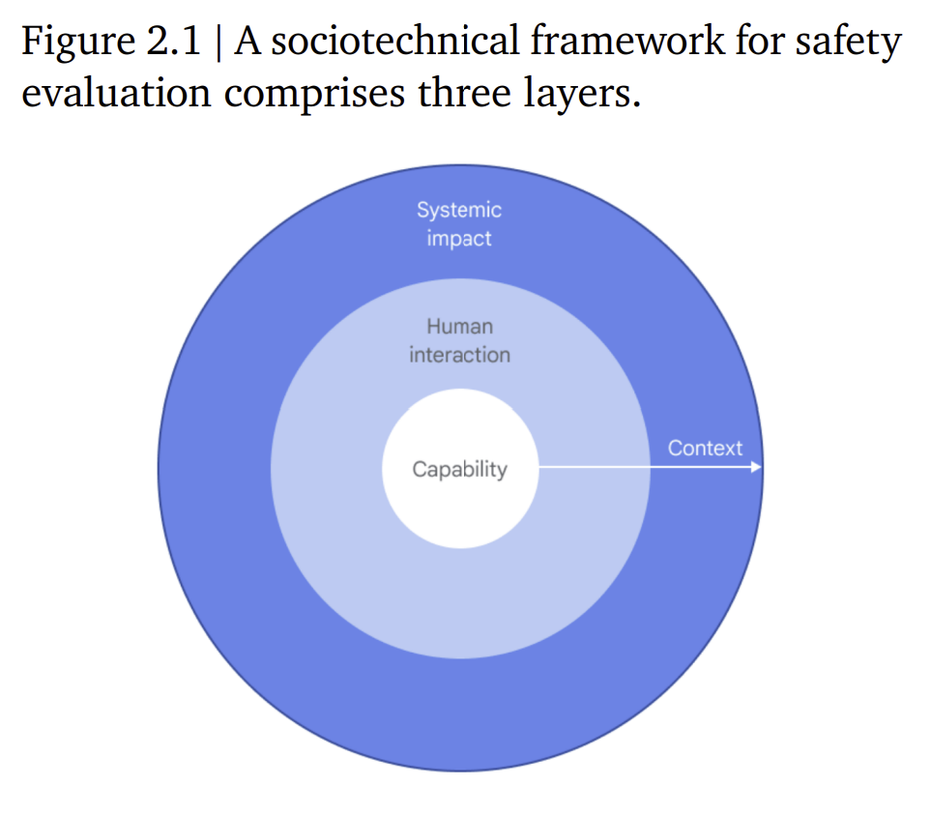
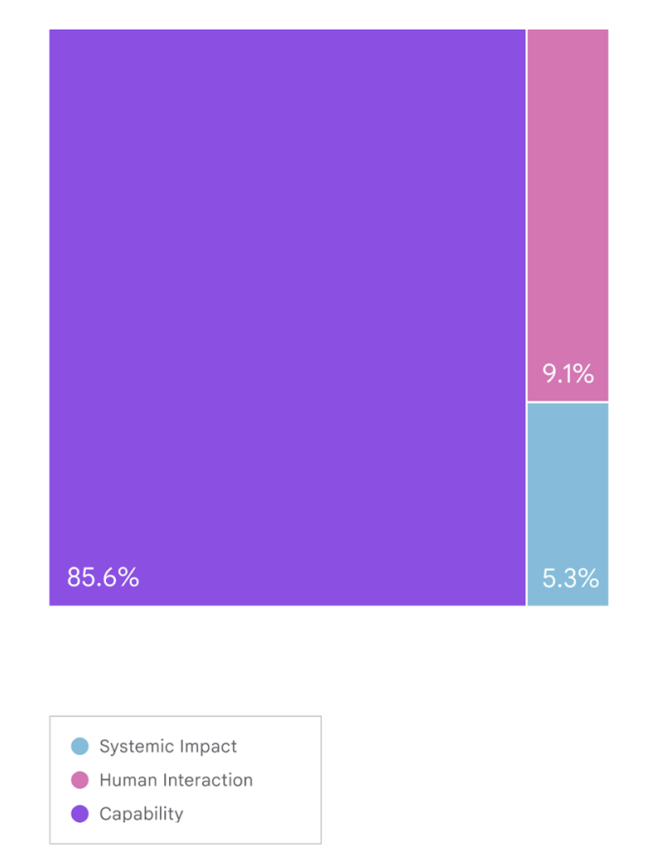
Where is the research space?
Most are one off sets of prompts:
Need more focus on users and groups
Not enough (in my view) on malicious actors
And, of course, evals will become training data
i.e. they will expire
Third party audits have lots of challenges
https://arxiv.org/abs/2310.11986

Slide 21
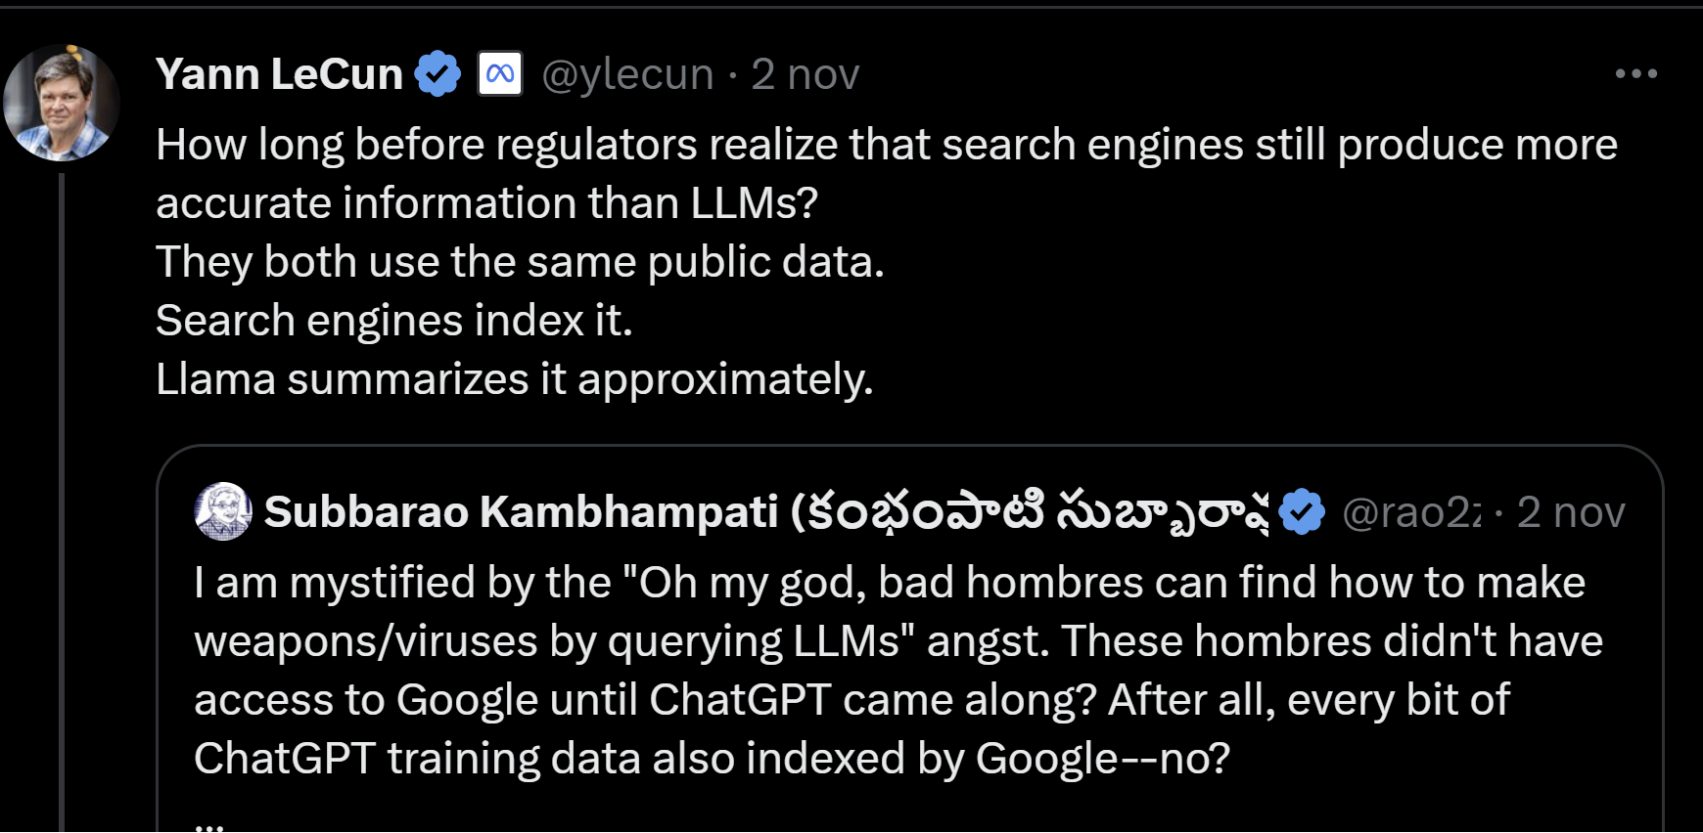
(Final slide) OST work in this area
We have ~10 years experience in studying malicious behaviour online
Incels, anti-vaxx, far right, ISIS, hate speech, etc. etc.
Want to drive safety research in terms of how malicious actors will *actually use* LLMs / genAI (no, not to actually make weapons, bombs etc.)
But still definitely possible to massify some harms
That will be next years challenge, and happy to collaborate ☺

